Slide 1
Department of Computer Science and Engineering
BLOCKCHAIN CHAT APPLICATION: DECENTRALIZED SECURE MESSAGING AND DATA STORAGE
PHASE - II
DOMAIN : BLOCKCHAIN DATE : 19.05.2025 YEAR : IV SEMESTER: VIII | GUIDED BY: Mrs.V.Saranya B.Tech., M.Tech., MBA.,(Ph.D)., ASSISTANT PROFESSOR/CSE | TEAM MEMBERS R.Sharvesh (21TD0645) S.Devanand (21TD0610) C.Saran (21TD0639) E.Gopikrishnan (21TD0614)

Slide 2
BLOCKCHAIN CHAT APPLICATION: DECENTRALIZED SECURE MESSAGING AND DATA STORAGE

Slide 3
ABSTRACT
The Purpose of this Blockchain-based messaging platform to address existing system shortcomings like Smart Contract and AES. It utilizes End-to-End Encryption , SHA-256 Hashing Algorithm, and Smart Contracts to ensure message confidentiality. The platform adopts a Ethereum network. Enhances data privacy with End-to-End Encryption (E2EE) using Blowfish Algorithm . The network can continue to operate and reach consensus as long as the majority of the nodes are honest and working correctly. The PoS (Proof of Stake) is used for creating nodes in Ethereum Network. The Smart Contract is used to optimize Message Storing and retrieval, while WebSocket enables real-time updates. Also user can send and receive files that stored on Blockchain.

Slide 4
Objective
To design and develop a secure, decentralized instant messaging platform using Blockchain technology.
To implement End-to-End Encryption (E2EE) using cryptographic techniques (e.g., Blowfish algorithm) to ensure message confidentiality.
To use Smart Contracts on the Ethereum network for automating chat-related operations like message verification and access

Slide 5
LITERATURE SURVEY
S.No | TITLE | AUTHOR NAME | YEAR OF PUBLICATION | TECHNIQUE USED | ADVANTAGES | DISADVANTAGES
1. | A Survey of Blockchain Based Systems. | Turki Ali Alghamdi, Rabiya Khalid | 2024 | consensus mechanisms, smart contracts | Improving data processing speed. | Not scalable in private blockchain.
2. | The Role of Blockchain in Finance Beyond Cryptocurrency. | Hanfang Chen, Niankun Wei | 2024 | (PoW) Proof of Work. | Enhancing data security. | PoW challenges due to slow transaction processing times.
3. | A Secured Peer-to-Peer Messaging System Based on Blockchain. | Shamim Ahmed , Milon Biswas | 2022 | PKI (Public Key Infrastructure) | message cannot be altered or tampered. | system only supports text-based message
4. | A Survey on Blockchain for Healthcare: Challenges, Benefits, and Future Directions. | Mohammad Salar Arbabi , Chhagan Lal | 2022 | BFT (Byzantine Fault Tolerance) | Data stored on-chain is protected | The system only supports text-based
5. | SocialChain: Decoupling Social Data and Applications to Return Your Data Ownership. | Ting Cai , Zicong Hong | 2021 | PDS (Personal Data Store ) | Users to store their social data outside of the blockchain while keeping only essential metadata on-chain. | Storing large datasets on-chain can be prohibitively expensive

Slide 6
ABSTRACT OF EXISTING SYSTEM:
Social media services enable global communication via instant messaging (IM) platforms. However, their widespread usage has resulted in server regulation issues because most are centralized, while they also pose privacy concerns due to endpoint-based security vulnerabilities. In response, we present a private blockchain-based IM platform that utilizes blockchains to secure data through immutability. We implement it in a RESTful Application Programming Interface (RESTAPI) Web server for better load balancing compared to the centralized IM architectures via decentralization. We further implement end-to-end encryption (E2EE) using public-private key pairs to improve data privacy. We evaluated the proposed design by highlighting its advantages over centralized IM Platforms.

Slide 7
Drawbacks of Existing system
Data Security
No Smart Contract
Secure and Efficient Communication
Data Storage

Slide 8
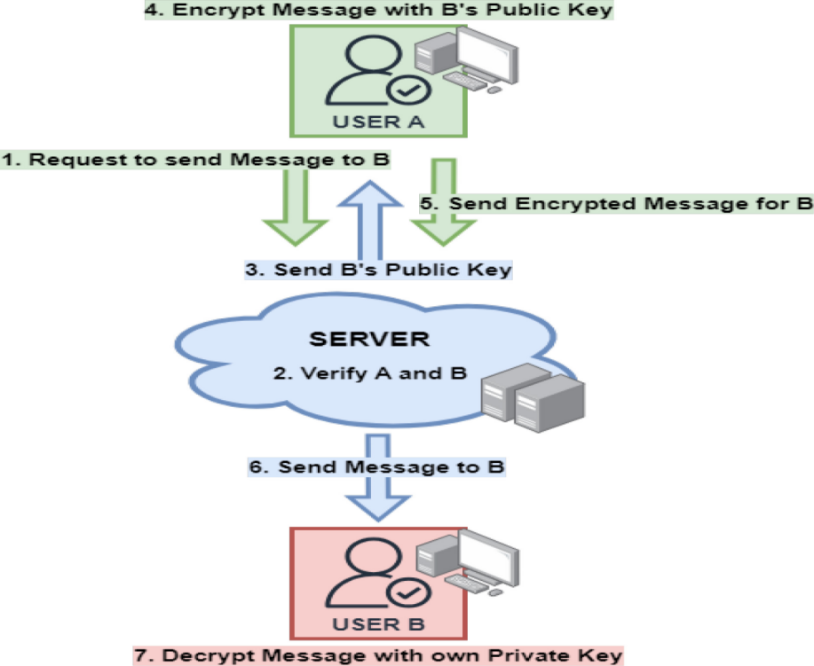
Architecture of existing system

Slide 9
ABSTRACT OF Proposed system
The Purpose of this Blockchain-based messaging platform to address existing system shortcomings like Smart Contract and AES. It utilizes End-to-End Encryption , SHA-256 Hashing Algorithm, and Smart Contracts to ensure message confidentiality. The platform adopts a Ethereum network. Enhances data privacy with End-to-End Encryption (E2EE) using Blowfish Algorithm . The network can continue to operate and reach consensus as long as the majority of the nodes are honest and working correctly. The PoS (Proof of Stake) is used for creating nodes in Ethereum Network. The Smart Contract is used to optimize Message Storing and retrieval, while WebSocket enables real-time updates. Also user can send and receive files that stored on Blockchain.

Slide 10
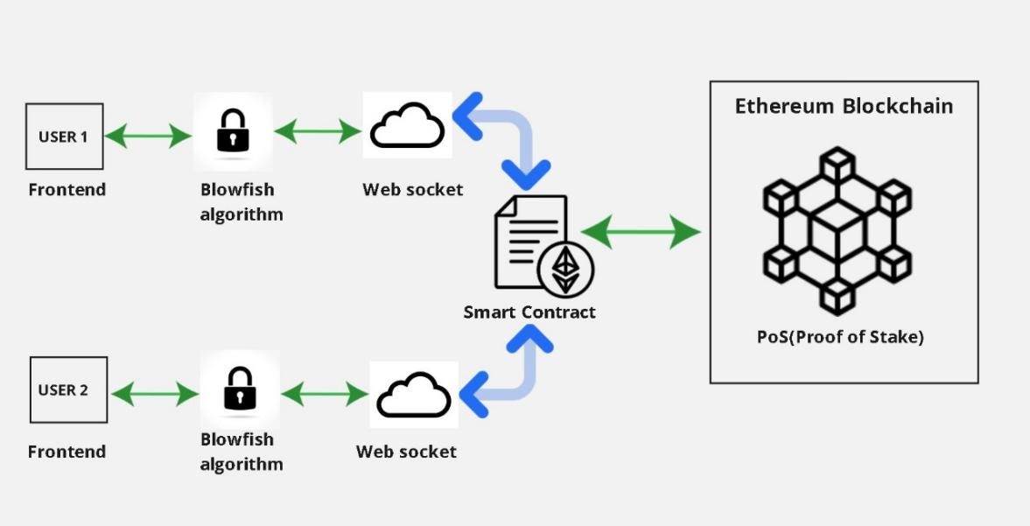
Architecture of proposed system

Slide 11
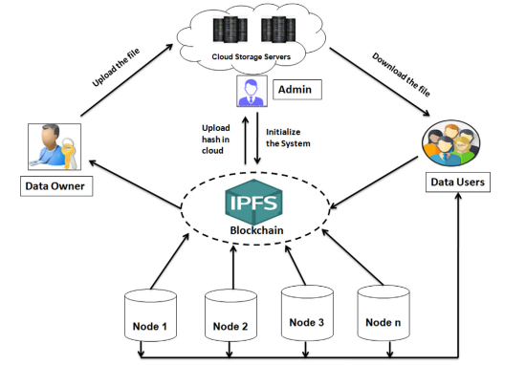
Architecture Diagram for IPFS Server with Data Storage

Slide 12
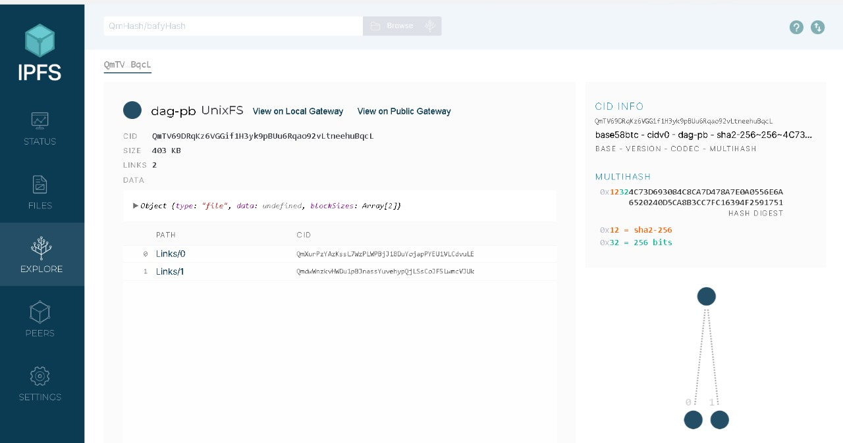
IPFS (InterPlanetary File System) SERVER

Slide 13
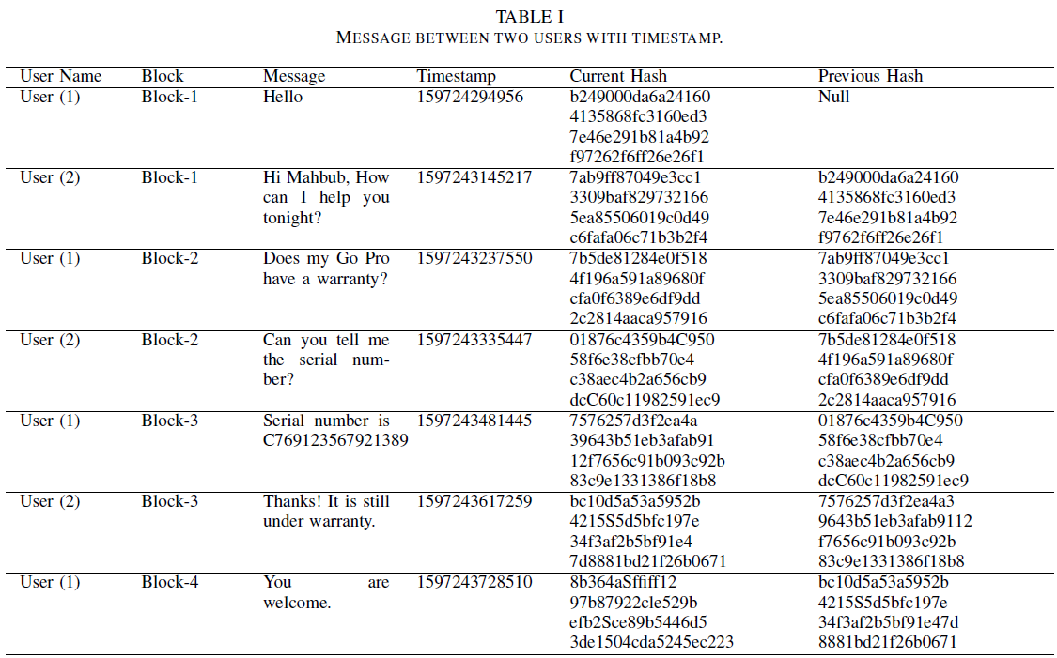

Slide 14
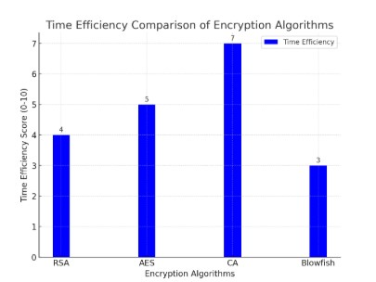
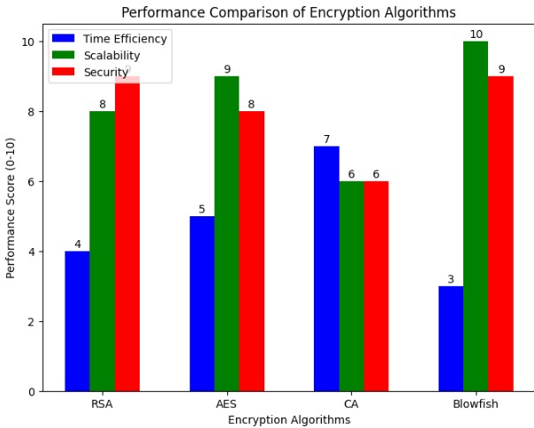
Result analysis

Slide 15
Conclusion
The proposed Blockchain-based Instant Messaging (IM) system effectively overcomes privacy, security, and cost issues found in centralized platforms. It uses Proof of Stake (PoS) for efficient, energy-saving consensus, and Blowfish encryption for fast and secure End-to-End Encryption (E2EE). Features like access control and audit logs boost transparency and security. Results show improved authentication, faster encryption, and better file handling. Overall, the system offers a secure, scalable, user-friendly, and privacy-focused alternative to traditional messaging apps. Future enhancements may include sharding and latency optimization for improved scalability.

Slide 16
References :
[1] T. Cai, Z. Hong, S. Liu, W. Chen, Z. Zheng, and Y. Yu, “SocialChain:Decoupling social data and applications to return your data ownership,”
IEEE Trans. Services Comput., vol. 16, no. 1, pp. 600–614,
Jan./Feb. 2023.
[2] X. Zhu, D. He, Z. Bao, M. Luo, and C. Peng, “An efficient decentralized identity management system based on range proof for social
networks,” IEEE Open J. Comput. Soc., vol. 4, pp. 84–96, Mar. 2023.
[3] F. Li, X. Yu, R. Ge, Y. Wang, Y. Cui, and H. Zhou, “BCSE: Blockchainbased trusted service evaluation model over big data,” Big Data Min.
Anal., vol. 5, no. 1, pp. 1–14, Mar. 2022.
[4] A. Theophilo, R. Giot, and A. Rocha, “Authorship attribution of socialmedia messages,” IEEE Trans. Comput. Soc. Syst., vol. 10, no. 1,
pp. 10–23, Feb. 2023.
[5] P. Piamjinda et al., “CHIVID: A rapid deployment of community and home isolation during COVID-19 Pandemics,” IEEE J. Transl. Eng. Health Med., vol. 12, pp. 390–400, 2024.

Slide 17
[6] S. Chakraborty, K. Mazumdar, D. De, and S. Kumar, “RMS: A delaysensitive road monitoring system using edge intelligence,” IEEE Sensors., vol. 23, no. 3, pp. 2643–2650, Feb. 2023.
[7] A. Bozorgi et al., “I still know what you did last summer: Inferringsensitive user activities on messaging applications through trafficanalysis,” IEEE Trans. Dependable Secure Comput., vol. 20, no. 5,pp. 4135–4153, Sep./Oct. 2023.
[8] C. Gouert and N. G. Tsoutsos, “Dirty metadata: Understanding a threatto online privacy,” IEEE Security Privacy, vol. 20, no. 6, pp. 27–34,Nov./Dec. 2022.
[9] H. Yi, “Secure social Internet of Things based on post-quantumblockchain,” IEEE Trans. Netw. Sci. Eng., vol. 9, no. 3, pp. 950–957,May/Jun. 2022.
[10] I. Vakilinia, W. Wang, and J. Xin, “An incentive-compatible mechanismfor decentralized storage network,” IEEE Trans. Netw. Sci. Eng., vol. 10,no. 4, pp. 2294–2306, Jul./Aug. 2023.
[11] M. S. Arbabi, C. Lal, N. R. Veeraragavan, D. Marijan, J. F. Nygård,and R. Vitenberg, “A survey on blockchain for healthcare: Challenges,benefits, and future directions,” IEEE Commun. Surveys Tuts., vol. 25,no. 1, pp. 386–424, 1st Quart., 2023.
[12] X. Li and W. Wu, “Recent advances of blockchain and its applications,”J. Soc. Comput., vol. 3, no. 4, pp. 363–394, Dec. 2022.
[13] R. Du, C. Ma, and M. Li, “Privacy-preserving searchable encryptionscheme based on public and private Blockchains,” Tsinghua Sci.Technol., vol. 28, no. 1, pp. 13–26, Feb. 2023.

Slide 18
Future enhancement
Facial Recognition for Login
AI-based Threat Detection
Sharding for Scalability
Voice and Video Calling with Encryption

Slide 19


